Slide 1

Electromagnetic surveying
Dr. Laurent Marescot
laurent@tomoquest.com

Slide 2
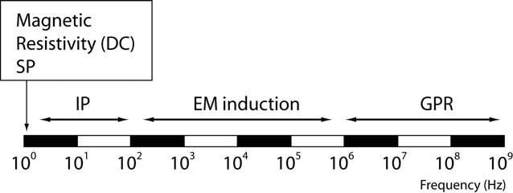
Introduction
Electrical surveying…
Resistivity method
Induced polarization method (IP)
Self-potential (SP) method
Higher frequency methods (electromagnetic surveys):
Electromagnetic induction methods
Ground penetrating radar (GPR)

Slide 3
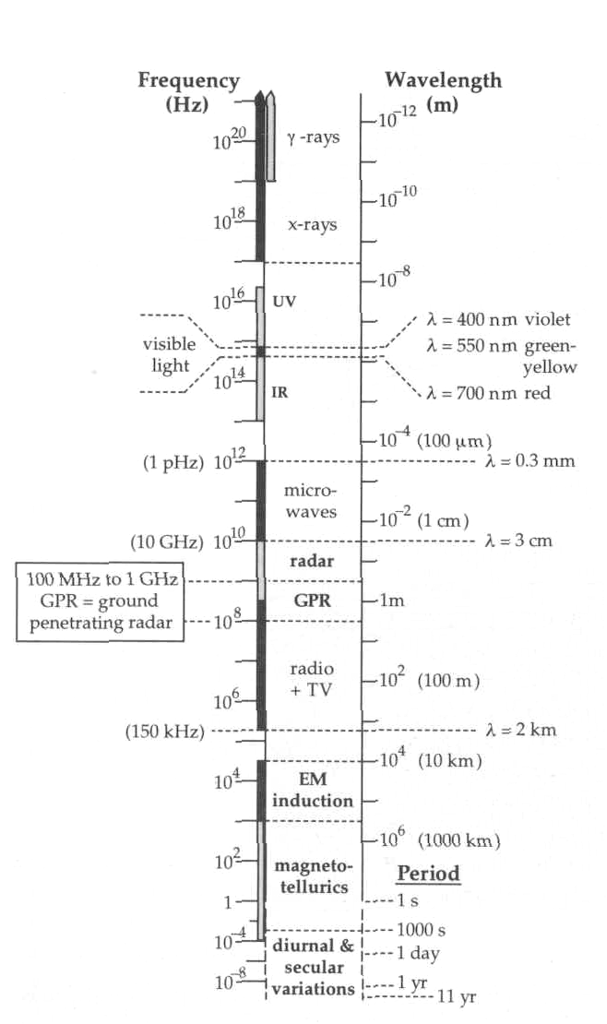

Slide 4
Electromagnetic method
Electromagnetic (EM) surveying methods make use of the response of the ground to the propagation of electromagnetic field. This response vary according to the conductivity of the ground (in S/m).
Primary EM fields are generated using a alternating current in a loop wire (coil) or a natural EM source
The response of the ground is the generation of a secondary EM field
The resultant field is detected by the alternating currents that they induce in a receiver coil

Slide 5
Application
Exploration of metalliferous mineral deposits
Exploration for fossil fuels (oil, gas, coal)
Engineering/construction site investigation
Glaciology, permafrost
Geology
Archaeological investigations

Slide 6
Structure of the lecture
Equations in electromagnetic surveying
Survey strategies and interpretation
Conclusions

Slide 7
1. Equations in electromagnetic surveying

Slide 8
Maxwell equations
∇ × E + ^{∂B} = 0
Faraday induction
∂t
∇ × H − ^{∂D} = j
Ampère − Maxwell
∂t
∂p
∇ ⋅ D = p or ∇ ⋅ j =
∇ ⋅ B = 0
E electrical field (V/m)
B magnetic induction field
H magnetic field strenght
∂t
(Vs/m² ) (A/m)
D displacement field (C/m² )
j current density (A/m² )
p
charge density (C/m³ )

Slide 9
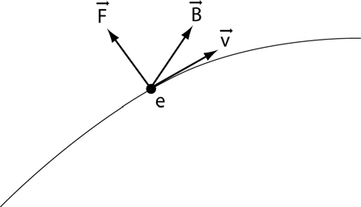
B and H fields
F = ev × B
H =
B
We can measure B, not H!
μ₀ μ
μ = 4π10⁻⁷
⎛ Vs ⎞
⎜ _{Am} ⎟
permeability for vacuum
Example of values for μ: Hematite, quartz: μ ≅1 Magnetite: μ ≅5
0
⎝ ⎠
μ permeability of material
B magnetic induction field
(Vs/m² )
H
magnetic field strenght
(A/m)
9

Slide 10
Frequencies
f frequency (Hz)
T period (s)
ω angular velocity (rad/s)
ω = 2π f = 2π ¹
T
In the field, some frequencies are considered as noise and must be filtered out:
Light
CFF/SBB
3rd harmonic
50 Hz
16.6 Hz
150 Hz

Slide 11
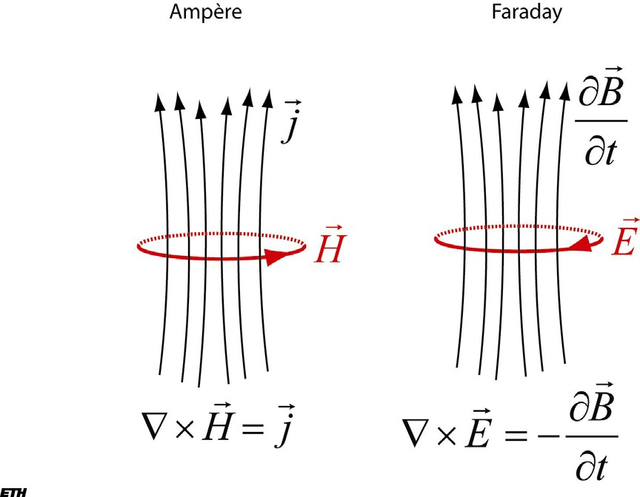
Basic theory: induction EM

Slide 12
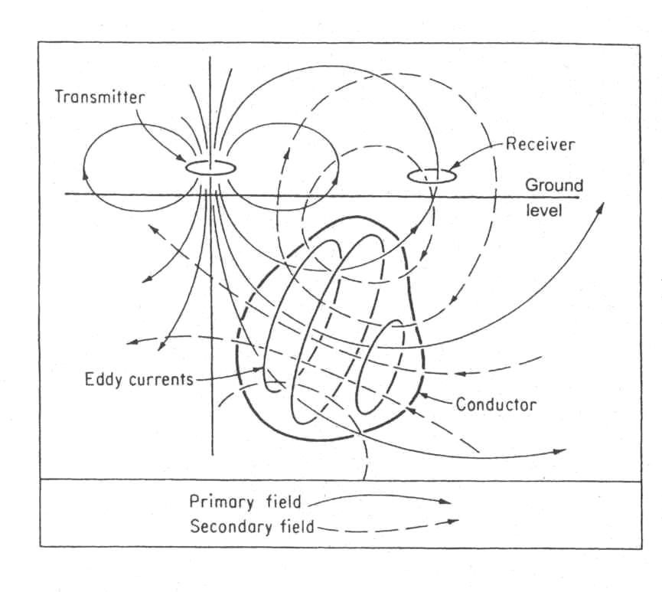
Basic theory: induction EM
∇ × H − ^{∂D} = j
∂t
Ampère-Maxwell
∇ × E + ^{∂B} = 0
∂t
Faraday

Slide 13
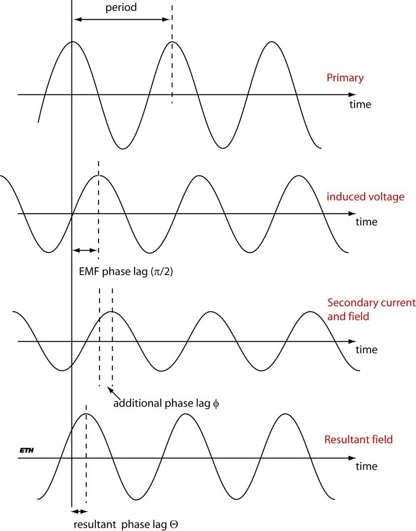
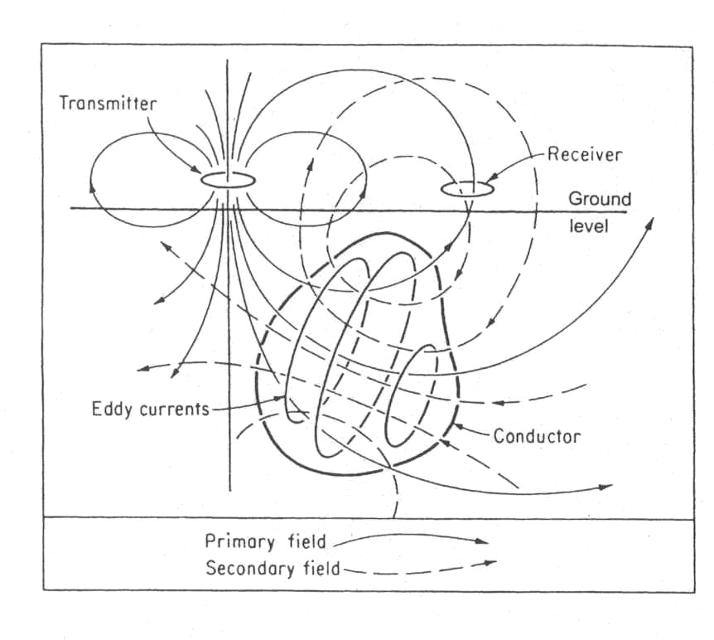
Θ= ^{π} + φ = ^{π} + tan⁻¹ (ωL / R)
2 2
R is the resistance of the conductor
L is the inductance of the conductor (or its tendancy to oppose a change
in the applied field)

Slide 14
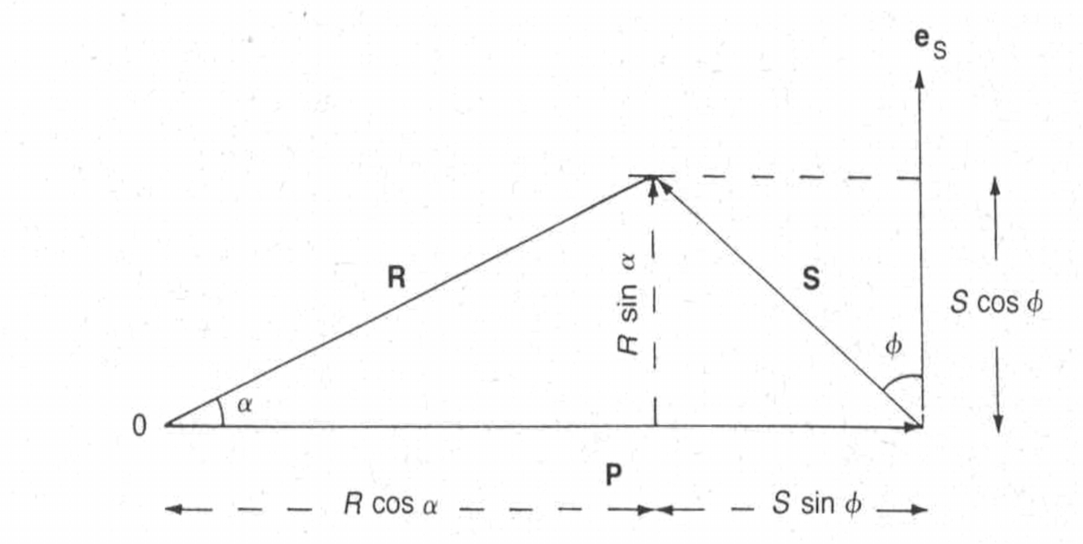
Real and imaginary components
Θ = ^{π} + φ = ^{π} + tan⁻¹ (ωL / R)
2 2
S sinφ
S cosφ
in-phase component (real)
out-of-phase component (imaginary)
14

Slide 15
Effect of a conductive body
Θ = ^{π} + φ = ^{π} + tan⁻¹ (ωL / R)
2 2
Large conductivity (R → 0 and φ → π/2): Θ → π
Low conductivity (R → ∞ and φ → 0): Θ → π/2
15

Slide 16
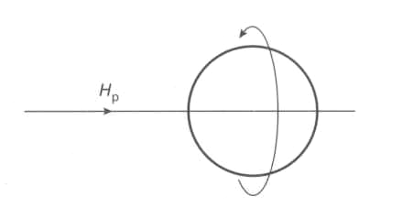
Tilt-angle methods
The receiving coil is turned until a null position is reached (no-signal): the plane of the coil then lies in the direction of
the arriving field
16

Slide 17
Depth of penetration and skin depth
Skin depth:
depth δ at which the amplitude of the field reaches 1/e of its original value a the source
2ρ ρ
δ =
≈ 503
μ₀ω
f
Depth of penetration: maximum depth z_{e} at which a conductor
may still produce a recognizable EM anomaly (empirical relation)
100
z_{e} ≈
σ f
17

Slide 18
2. Survey strategies and interpretation

Slide 19
Classification of EM methods
Uniform field methods
Magnetotelluric (MT)
Audio-magnetotelluric (AMT)
Very-Low Frequency (VLF-tilt, VLF-R)
Controlled source audio-magnetotelluric (CSAMT)
Dipolar field methods
Twin-coil or slingram systems: dipole source is used
Time-domain EM
Transient EM (TEM)

Slide 20
Magnetotelluric (MT)
The source are fields of natural origin (magneto-telluric fields) resulting from flows of charged particles in the ionosphere, correlated with diurnal variations in the geomagnetic field caused by solar emissions
The only electrical technique capable of penetrating to the depths of interest to the oil industry (mapping salt domes and anticlines)
Frequencies range from 10⁻⁵ Hz to 20 kHz

Slide 21
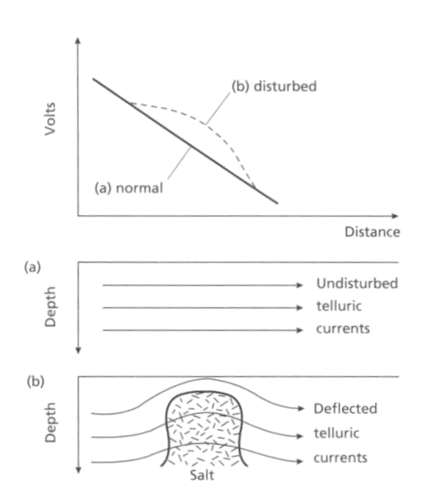

Slide 22
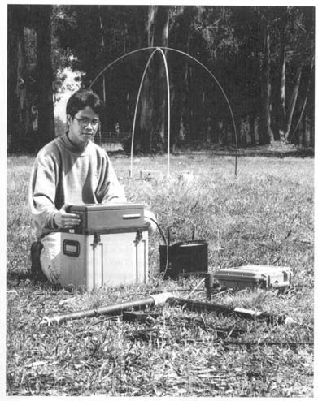
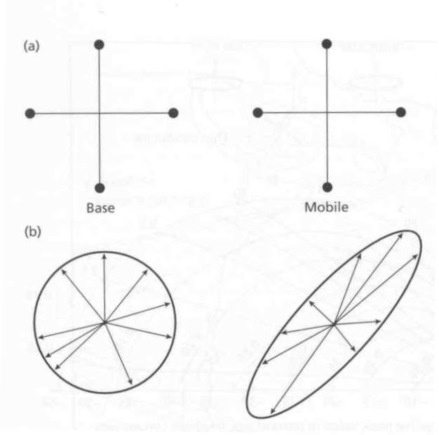
Telluric measurements
unit base circle area (A )
measured ellipse area (A²² )
1
2

Slide 23
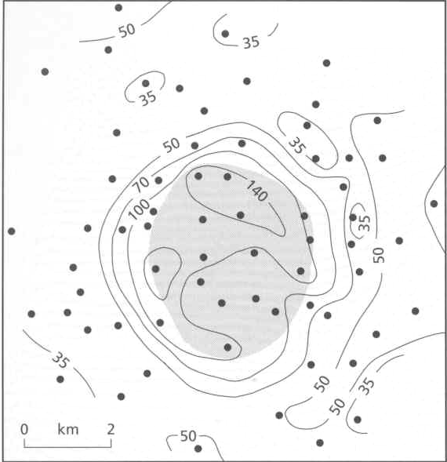
Map of A /A for a salt dome
23
2 1

Slide 24
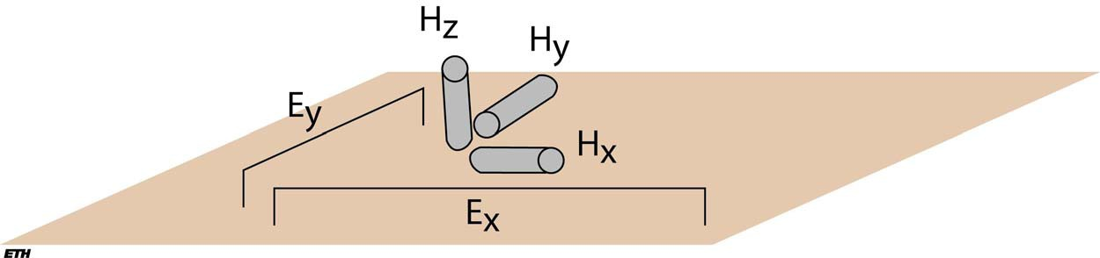
MT measurements
2
1
1 E_{x} (ω )
ρ (ω ) =
Z (ω ) ² =
a
ωμ₀
ωμ₀ H _{y} (ω )

Slide 25
Audio-magnetotelluric (AMT)
Use equatorial thunderstorms as sources (1 to 20 kHz).
These EM fields are called sferics. Sferics propagated around the Earth between the ground and the ionosphere
The very broad frequency spectrum can be filtered to select a depth of investigation up to 1 km (AMT soundings)
Method sensitive to noise in urban areas

Slide 26
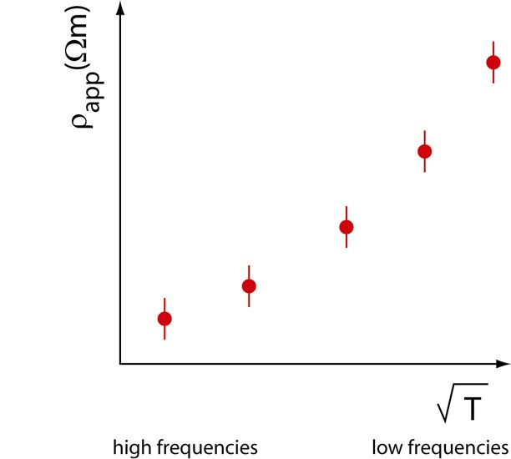
AMT-MT sounding
0.2 ⎛ E ⎞
2
ρ =
⎜ ⎟
a
f
⎝ H ⎠

Slide 27
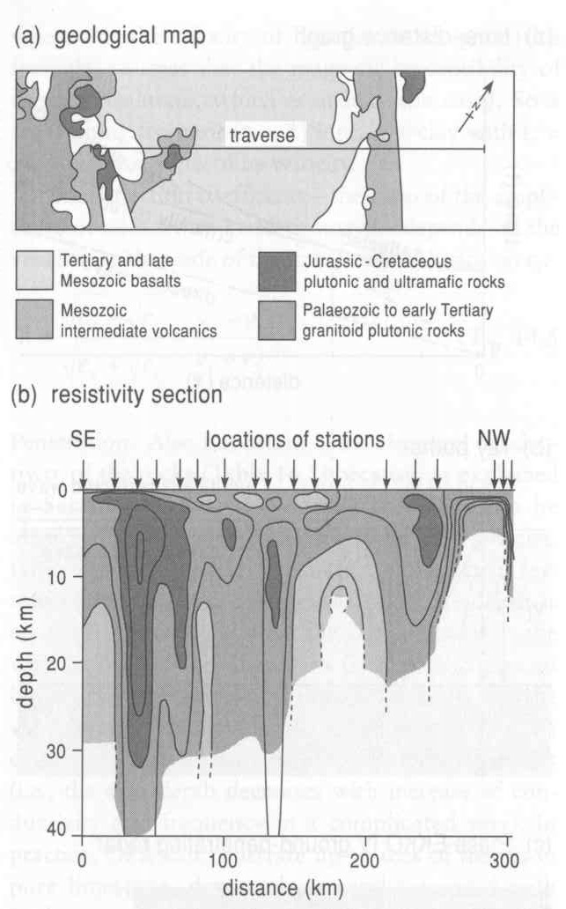

Slide 28
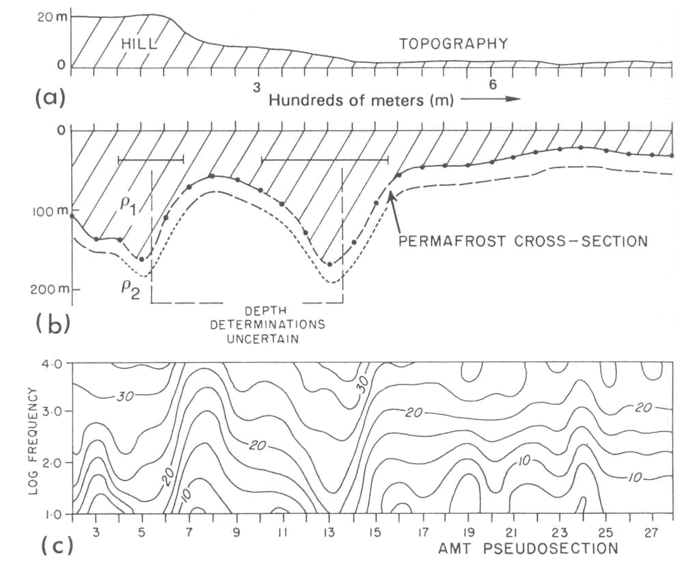
28

Slide 29
Very-Low Frequency (VLF-tilt)
Use submarine communication waves as sources (10 to 30 kHz). The transmitters are very powerful (>1 MW).The primary EM field is planar and horizontal
The depth of investigation mainly depends on the conductivity of rocks and the transmitter chosen (from 10m to 100m)
Disadvantages: transmission frequently broken, difficult to find a transmitter in an appropriate direction
Advantages: light, fast and easy to use
29

Slide 30
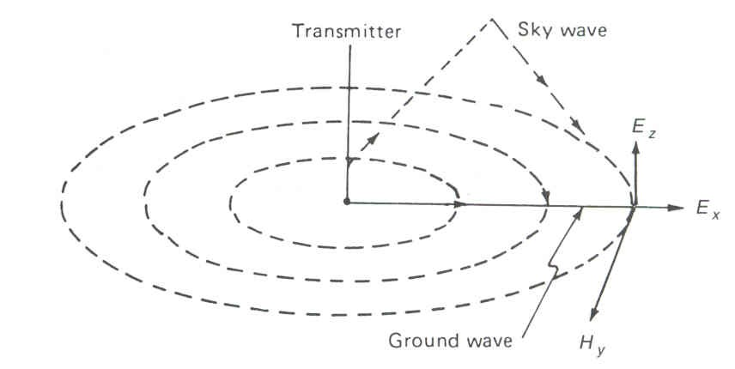
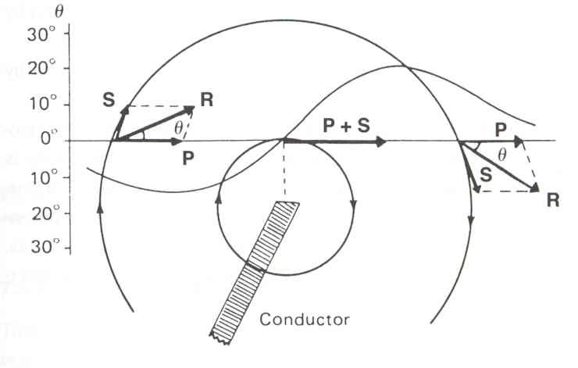
VFL-tilt measurements
30

Slide 31
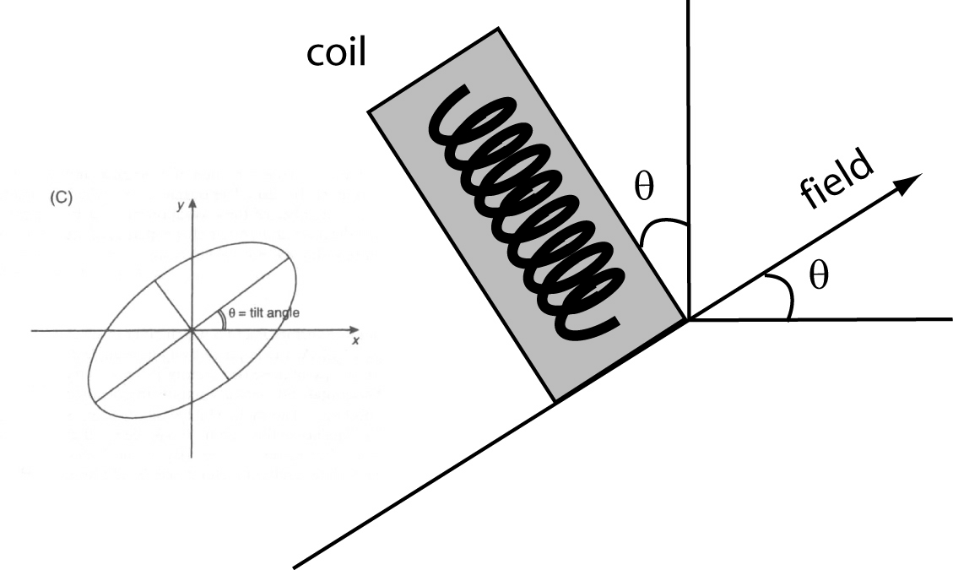
VFL-tilt measurements

Slide 32
Very-Low Frequency (VLF-R)
Gives apparent resistivity of the ground and phase shift by measuring H and E
Various local radio waves can be used to chose a depth of investigation (frequency can be chosen)

Slide 33
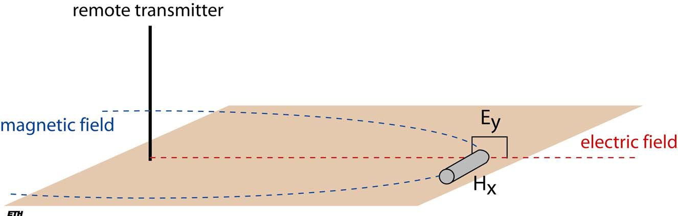
VLF-R measurements
0.2 ⎛ E ⎞
2
ρ =
⎜ ⎟
a
f
⎝ H ⎠

Slide 34
Controlled source AMT (CSAMT)
Similar to MT but using a remote (2 to 8 km) electrical dipole as source (1 Hz to 10 kHz)
The source frequency and location is known

Slide 35
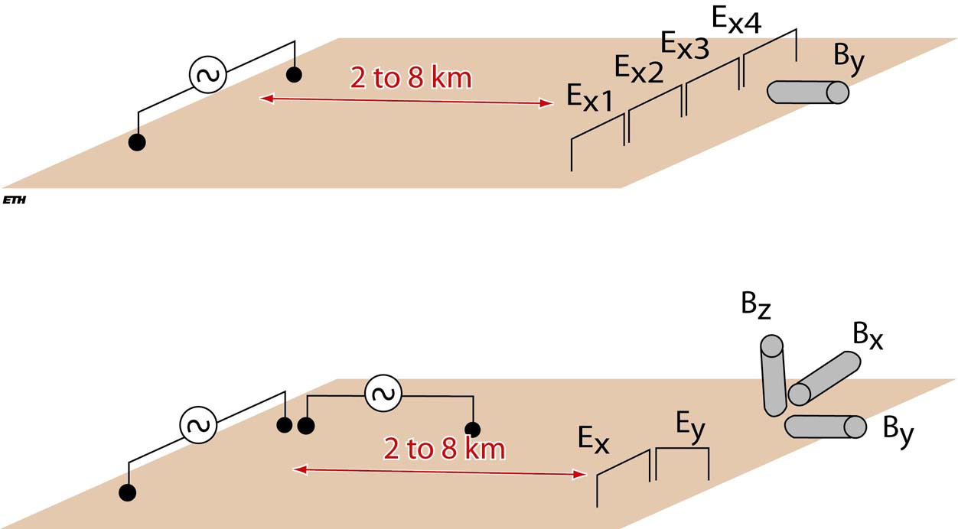
CSAMT measurements

Slide 36
Dipole-source methods
Measurements tolls called twin-coil or slingram systems
Tx and Rx are coils (about 1m diameter) linked by a cable which carries a reference signal in order to compensate the effect of the primary field. By this means, the system subsequently responds only to the secondary fields
A decomposer spilt the secondary field into real and imaginary components (display the result as a percentage of the primary field)

Slide 37
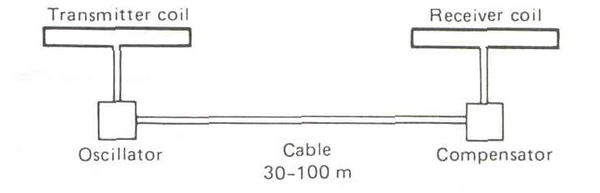

Slide 38
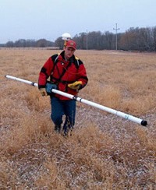
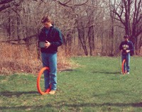

EM31 (Geonics), 9.8 kHz, s=3.66 m
EM34 (Geonics),
6.4 kHz for s=10 m
1.6 kHz for s=20 m
0.4 kHz for s=40 m
EM38 (Geonics), 14.6 kHz, s=1 m
38
s: Rx-Tx distance

Slide 39
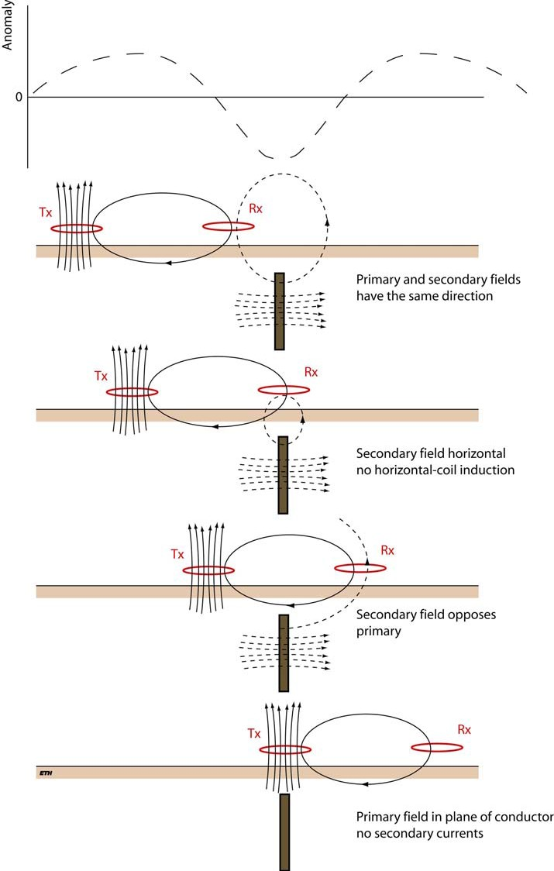

Slide 40
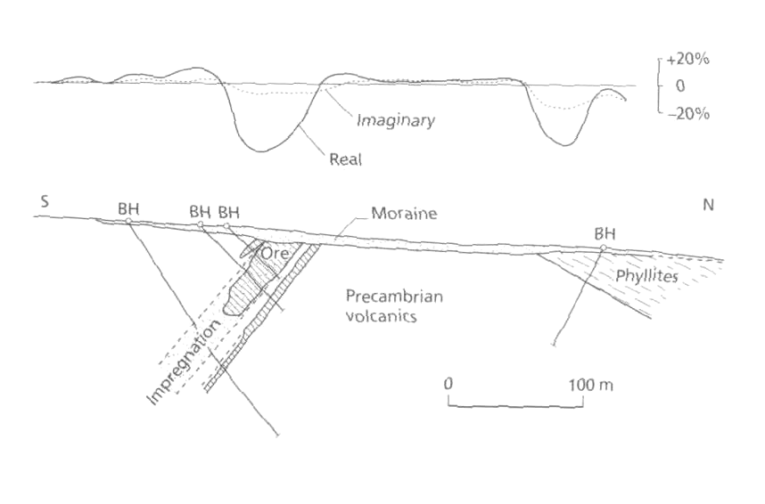

Slide 41
EM at low induction numbers (LIN)
Depth of investigation depends on the distance Tx-Rx
The response is proportional to ground conductivity
Manufacturer adapts the Rx-Tx distance (s) and frequency ( f ) for a LIN approximation, i.e. s<<δ:
4
N << 1 ⇒ ^{H S}
≅ σ
B
H iμ ωσs²
a
P
0
ρ
N = s / δ
is the induction number
δ ≅ 503
B
f

Slide 42
CST and VES using LIN
CST: moving vertical and horizontal dipoles with various constant depth (survey principle similar to resistivity CST and tomography)
VES: increasing Tx-Rx spacing around a same location point and using vertical and horizontal dipoles (survey principle similar to resistivity VES)

Slide 43
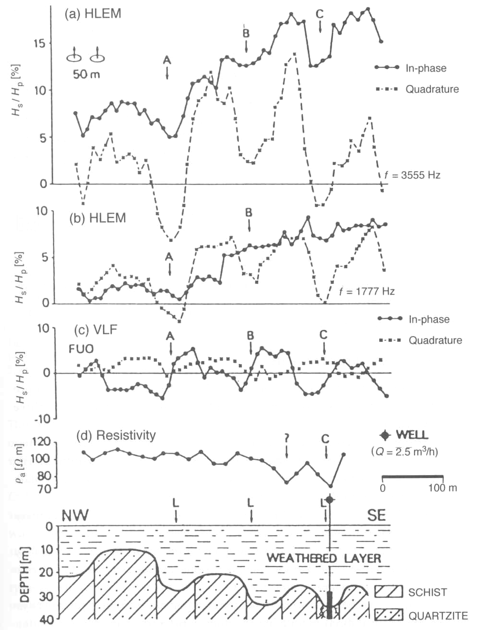

Slide 44
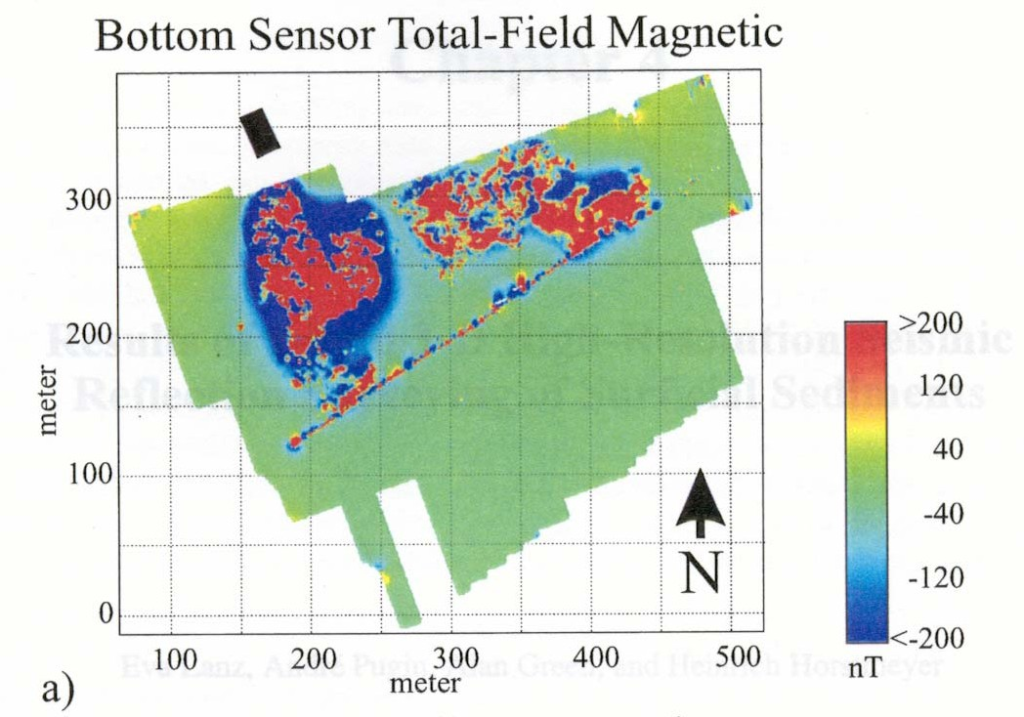
44

Slide 45
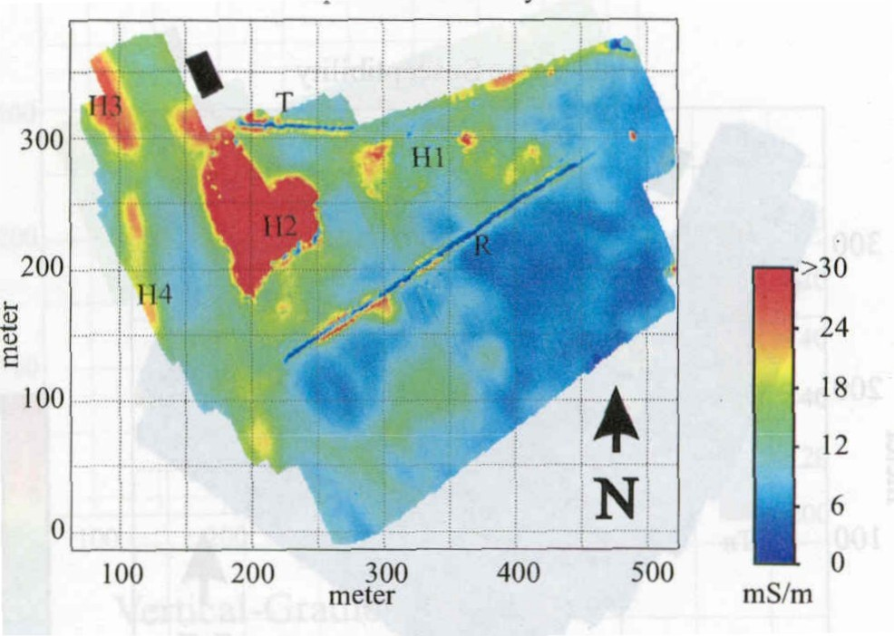
45

Slide 46
Transient EM (TEM)
TEM uses a primary field which is not continuous but consists of a series of pulses separated by measurement periods when the transmitter is inactive
Primary and secondary fields are clearly separated
Investigation depth up to several km could be achieved, but difficult to use in shallow geophysics (no reliable information in the 0-10 m depth range)

Slide 47
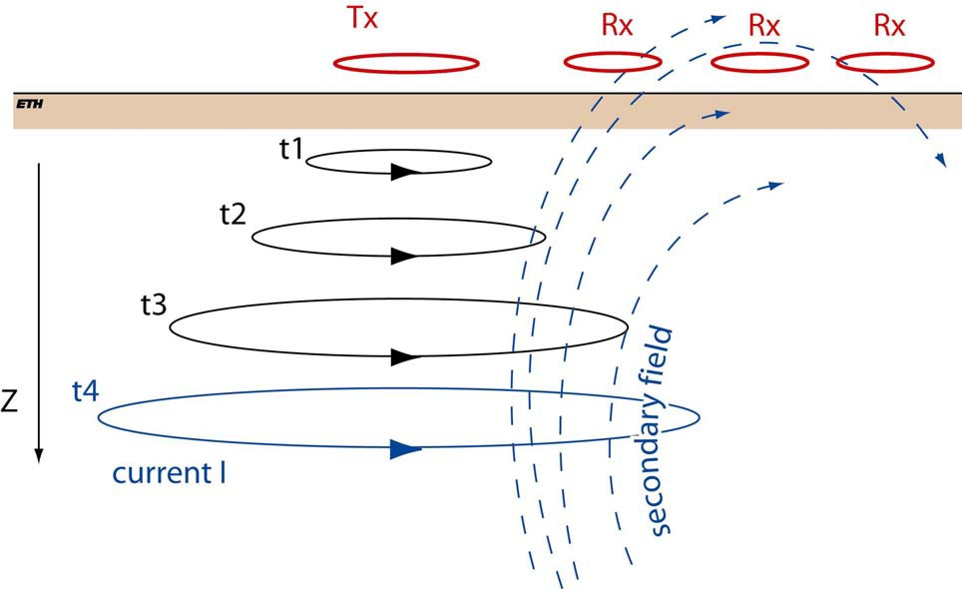
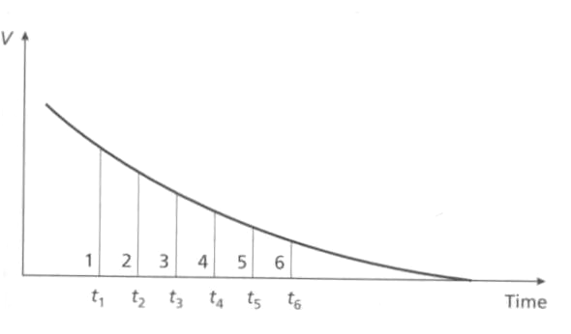
TEM measurements

Slide 48
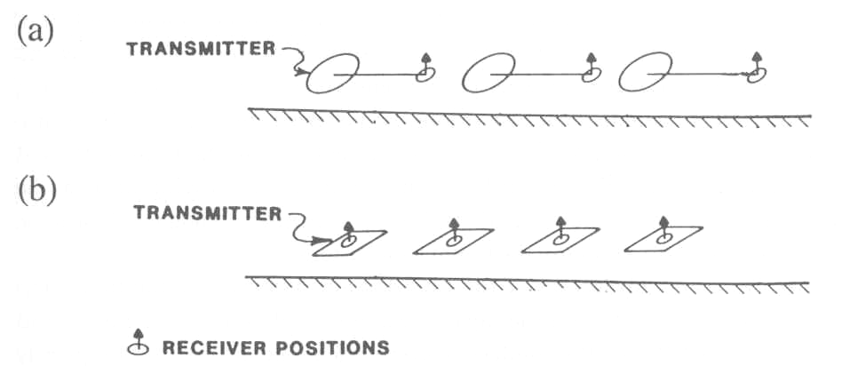
TEM measurements

Slide 49
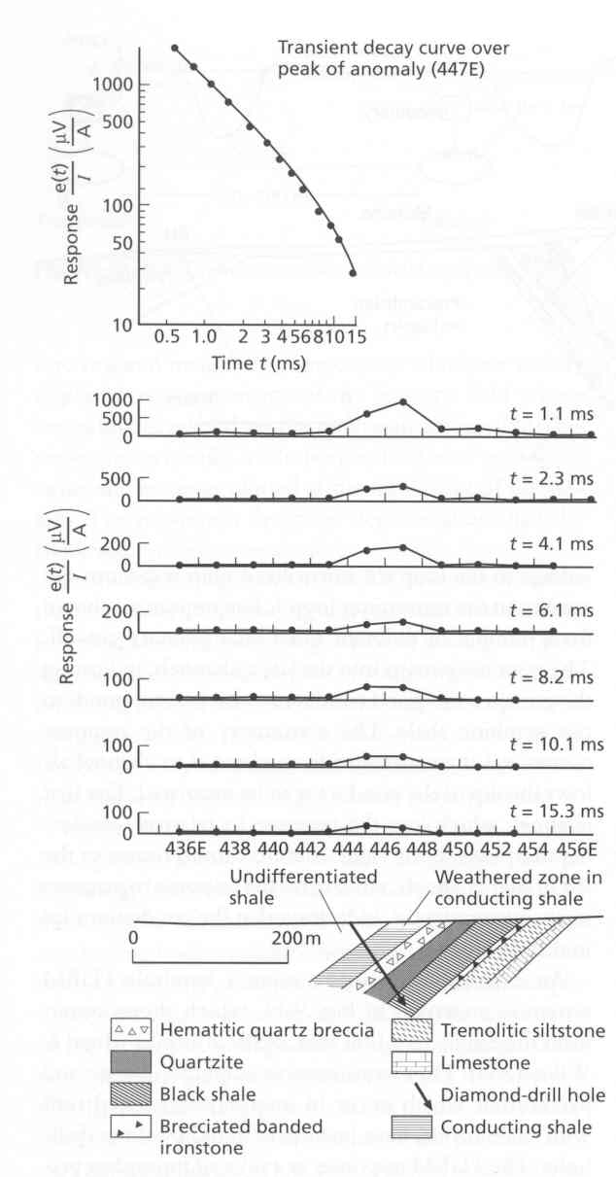

Slide 50
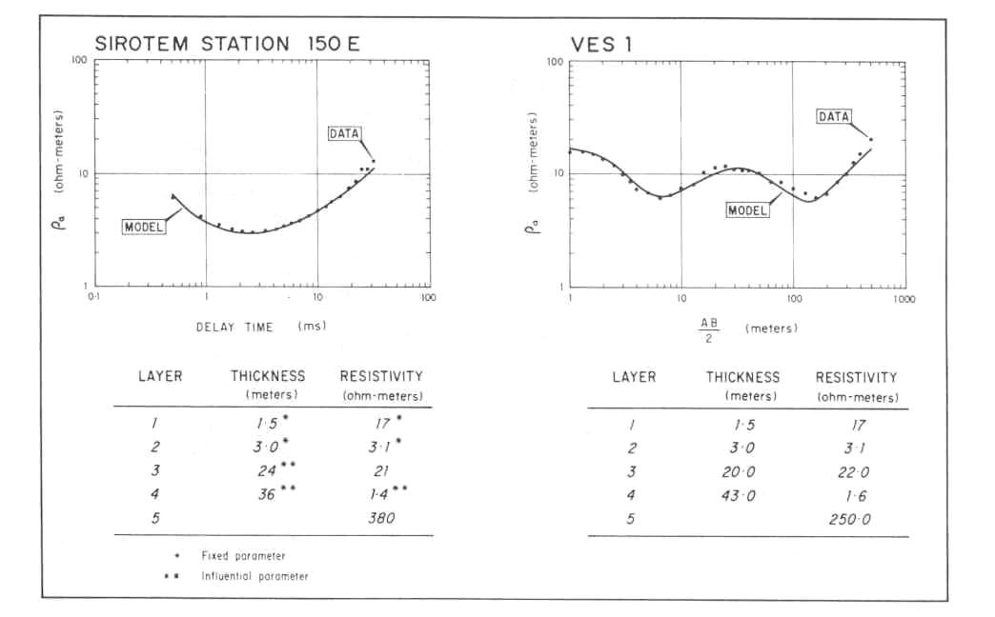
50

Slide 51
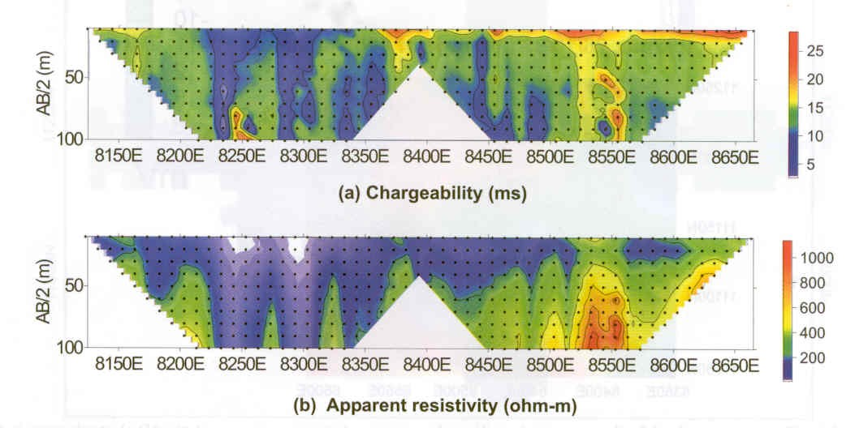
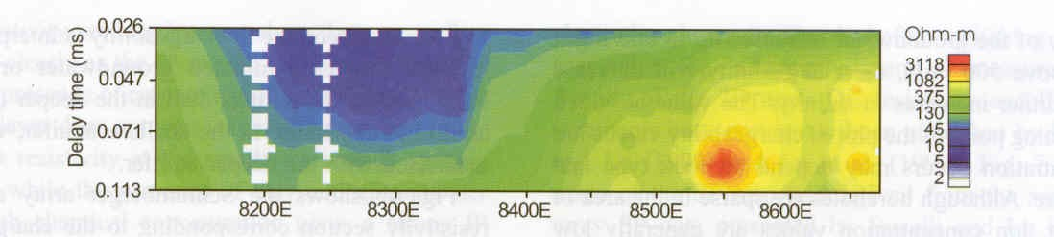

Slide 52
Remarks on interpretation
Indirect approach using theoretical computations of simple geometry shapes (spheres, cylinders, thin sheets, horizontal layers)
Laboratory modeling (using special scaling rules)
Use of master curves for simple Earth structures
Mainly qualitative. Quantitative inversion in development, soundings very used

Slide 53
3. Conclusions

Slide 54
Advantages
Surveys are easy to carry out, non-expensive (require less field operators than resistivity methods)
Rapid qualitative overview
No galvanic coupling with the ground required
Theoretically less sensitive to non-unicity in the solution than resistivity

Slide 55
Drawbacks
Quantitative interpretation of EM anomalies is complex
Penetration not very great if very conductive superficial layers are present

